Slide 1
Handwritten Words Recognition
Kalyan Lakshmanan

Slide 2





Marhuritin
Words
leogrition
Aalyon Labshmanan

Slide 3


Why?
Digitize my notes
Use Cases
Captcha Solver - Security
Document/Form digitization - $ / archival
Personality clustering - graphology
Ilthy
No.
If

Slide 4
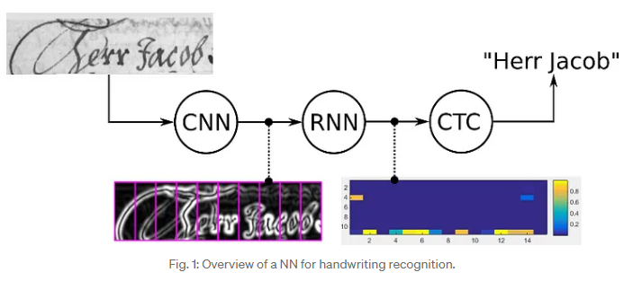
How?
Handwriting recognition

Slide 5
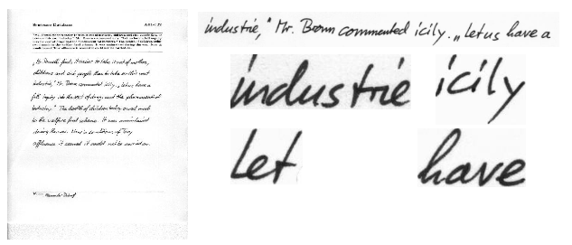
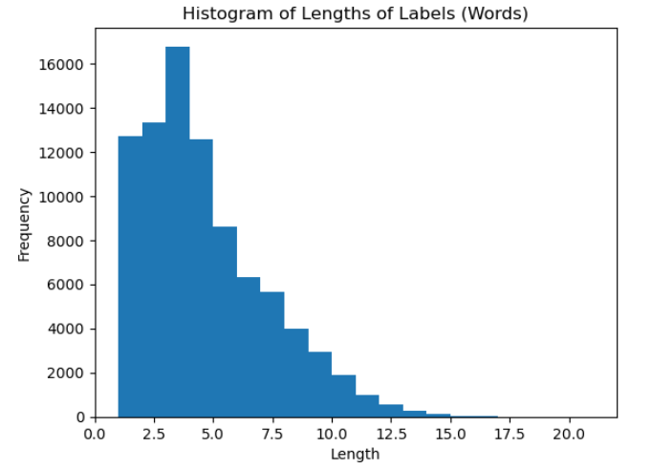
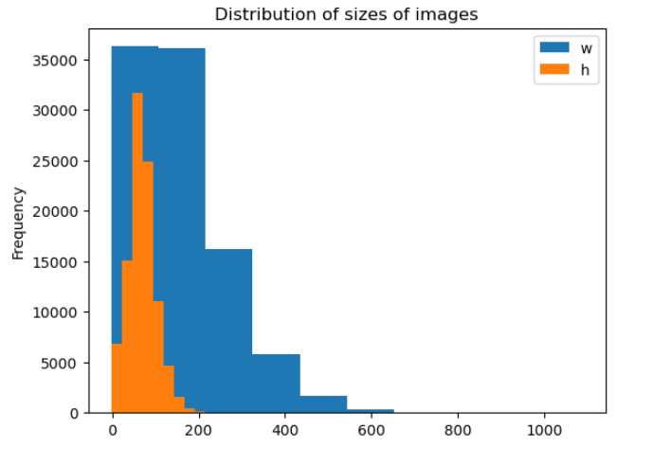
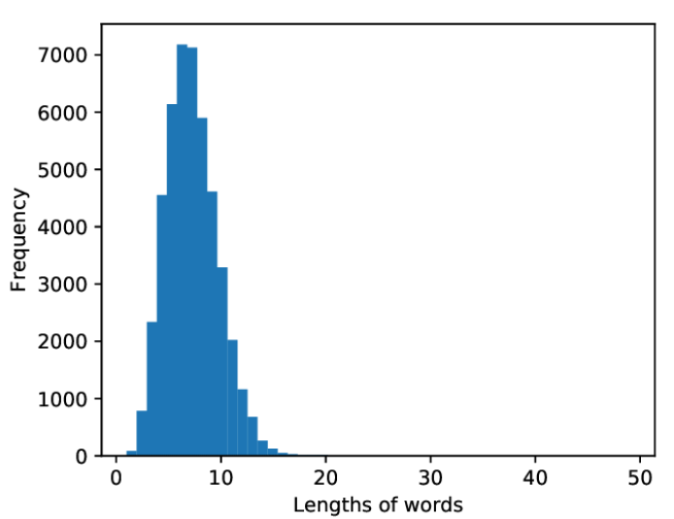
Data
IAM Dataset
1539 documents
> 13000 lines of text
Used as a benchmark
96,456 words
Notes:
Average width: 156.63427884216637 | Average height: 69.79688147963839

Slide 6


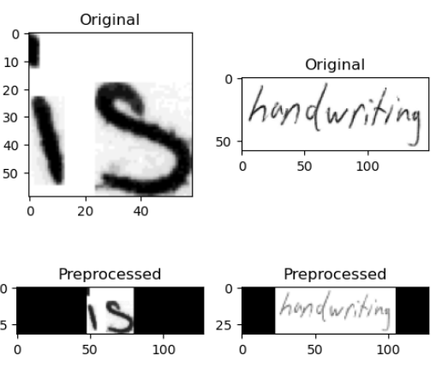
Processing / Data Pipeline
Tonyor
Flow
TENSORS
Images
Resize, Pad, Normalize
Labels
Tokenize, Pad
78 char classes

Slide 7
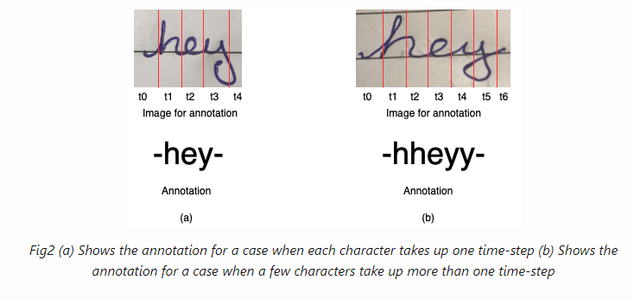
Connectionist Temporal Classification
sequence-to-sequence tasks where you have an input sequence (image of handwriting) and an output sequence (a sequence of characters).
Explanation of Connectionist Temporal Classification | Siddhant’s Scratch Book
Notes:
CTC loss is used in sequence-to-sequence tasks where you have an input sequence (image of handwriting) and an output sequence (a sequence of characters).

Slide 8
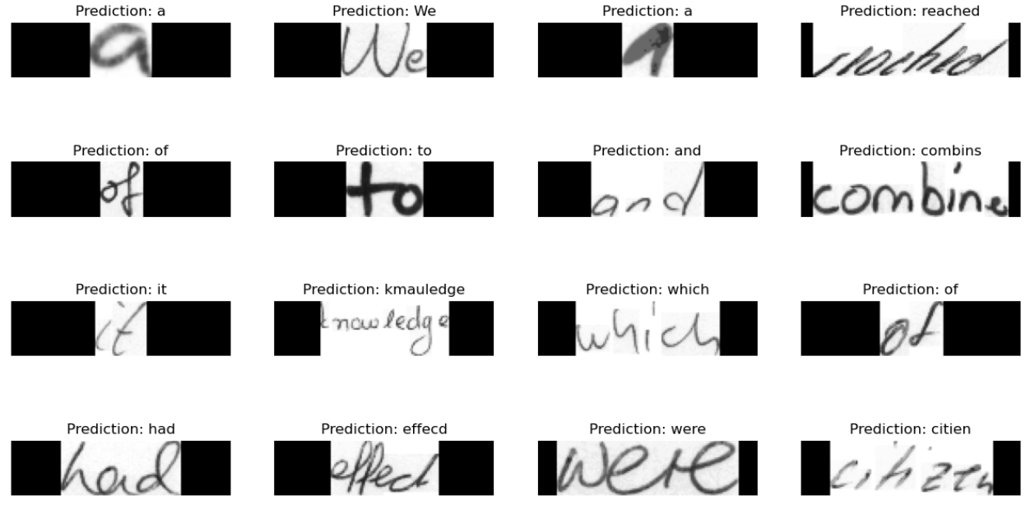

Slide 9
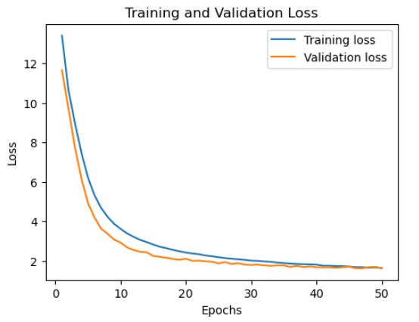
Edit Distance
measure of the similarity between two strings
Insertions / deletions / substitutions
Notes:
Mean edit distance for epoch 50 = 17.38

Slide 10

streamtit

Slide 11
Improvements
Preprocessing Pipeline - PIL to Tensor
Bounding Box
Automated Cropping
Train on more data
Fine tune to my handwriting
Image augmentation
Implement word segmentation for future pages

Slide 12
If

